Slide 1



Smart Seed Selection : Predicting seed performance
Supervised By: Dr. Wael Elsersy
Nada Elsaid 225047

Slide 2
Agenda
1 | Introduction
2 | Background
3 | Related work
4 | Problem statement
5 | Objective
6 | Proposed Solution
7 | Dataset
8 | System Architecture (Use case , Class diagram)
9 | Methodology
10 | Algorithm
11 | Results
12 | Demo
13 | Conclusion
14 | References

Slide 3
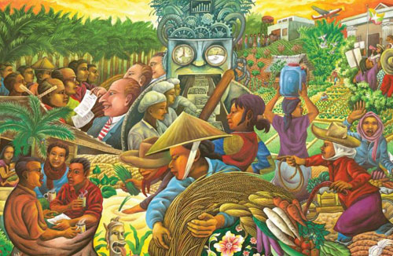
Introduction
Agriculture is vital for food production but faces challenges like climate change. This project leverages AI and computer vision to assess seed quality and predict crop yields. It aims to enhance farming productivity and sustainability.

Slide 4
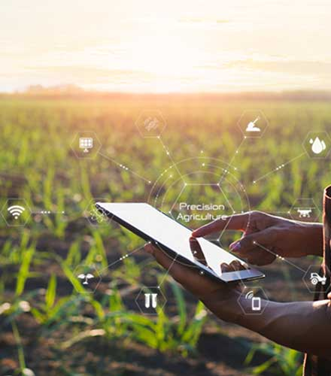
Background
The project develops a mobile app for seed quality and type prediction using CNNs. It leverages PyTorch for model training and provides a simple interface for users to upload seed images and get detailed reports, improving farming practices.

Slide 5
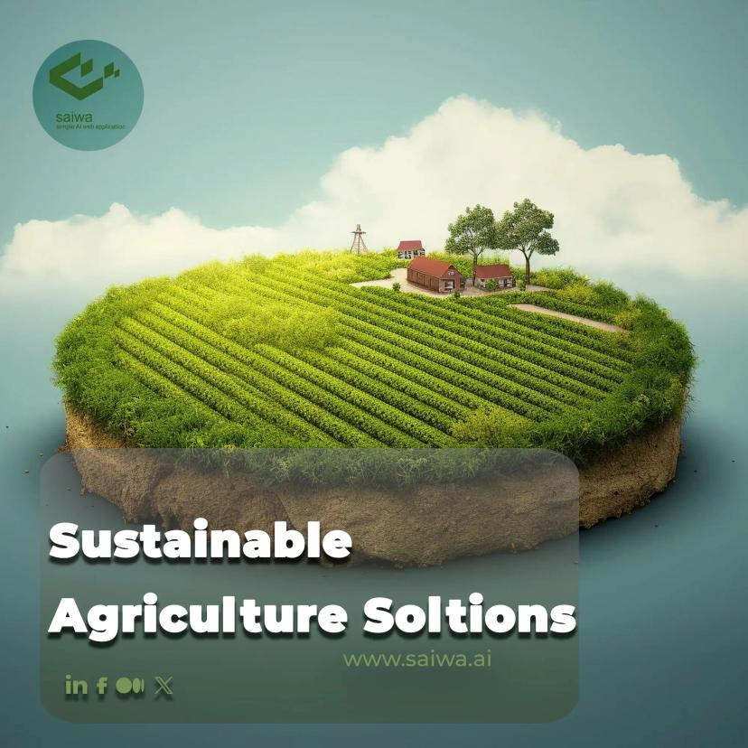
Related work
Method
The system uses computer vision and deep learning to analyse soybean, seeds images, automating quality assessment by classifying size, shape, and colour.
Applied Datasets
It employs the Soybean Seeds Dataset from Kaggle, containing labeled images crucial for model training (Koklu et al., 2021).
Results
AI approaches can achieve over 98% accuracy in seed quality assessment, enhancing decision-making (Koklu et al., 2021).
Limitations
The system may not work for all seed types and requires high-quality data. User adoption may be hindered by unfamiliarity with AI.

Slide 6
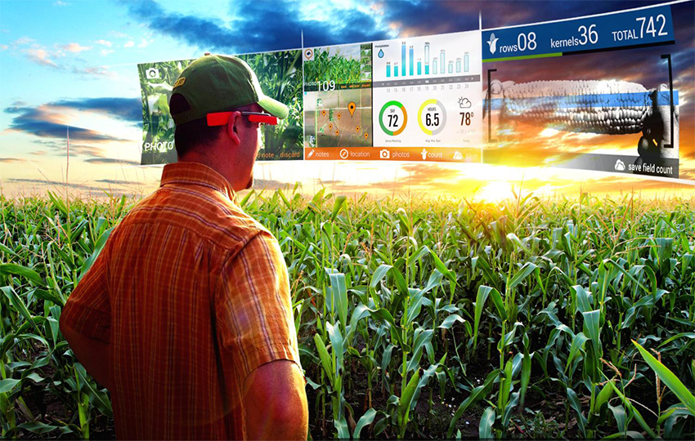
Related work
Rice and Pistachio
Method:
The system uses computer vision and deep learning to analyze Pistachio and Rice seed images, automating quality assessment by classifying size, shape, and color (Koklu et al., 2021; DOI: 10.3390/electronics11070981).
Applied Datasets:
It employs the Pistachio Dataset and Rice Dataset from Kaggle, containing labeled images that are crucial for model training and seed classification (Muratkoklu et al., 2021; DOI: 10.23751/pn.v23i2.9686).
Results:
AI approaches can achieve over 98% accuracy in seed quality assessment, enhancing decision-making for Pistachio and Rice seed classification (Koklu et al., 2021; DOI: 10.1016/j.compag.2021.106285).
Limitations:
The system may not work for all seed types, including Pistachio and Rice, and requires high-quality data. User adoption may be hindered by unfamiliarity with AI, The Dataset also unbalanced with cause overfiting and accuracy problems.

Slide 7

Problem statement
Traditional seed quality assessment methods are slow, subjective, and inaccurate, hindering agricultural productivity. The lack of an automated, reliable system for seed quality evaluation limits decision-making and the effectiveness of genetically modified seeds.

Slide 8
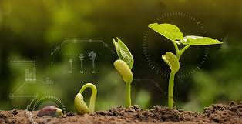
Objective
Type Detection: Use machine learning to classify seed types based on image analysis.
Quality Detection: Use machine learning to assess seed quality based on image analysis.
Accurate Classification: Classify seeds into quality categories (e.g., high, medium, low).
Automated Evaluation: Provide fast and reliable quality assessments for improved decision-making.

Slide 9
Proposed Solution
The seed quality prediction system aims to analyse soybean, rice, and pistachio seed images using deep learning. Our goal is to classify seeds based on size, shape, and colour, providing accurate quality assessments to support agricultural decision-making.

Slide 10
Dataset
Dataset 1 name: Soybean Seeds.
Dataset 2 name : Pistachio Image Dataset.
Dataset 2 name: Rice Image Dataset.
Source : Kaggle
Description : The Soybean Seeds dataset contains 5,513 images of soybean seeds, classified into five categories: intact, spotted, immature, broken, and skin-damaged.
The Pistachio Dataset consists of 2,148 images, divided into two types: Kirmizi_Pistachio and Siirt_Pistachio. The dataset is used for classifying and assessing the quality of pistachio seeds based on their visual characteristics.
The Rice Images Dataset75,000 images of rice seeds, classified into five types: Arborio, Basmati, Ipsala, Jasmine, and Karacadag. It is used for classifying and assessing the quality of different rice seed varieties based on their visual features.

Slide 11
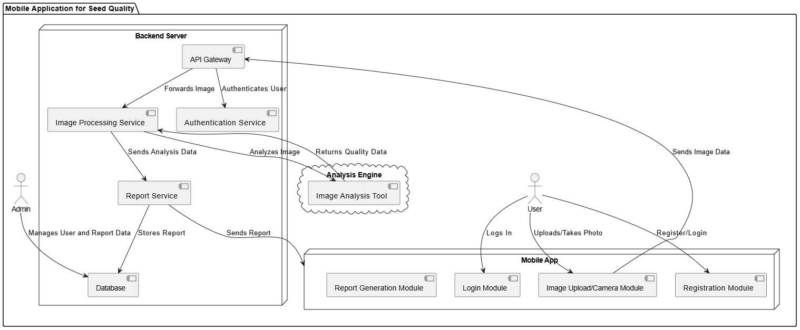
System Architecture

Slide 12
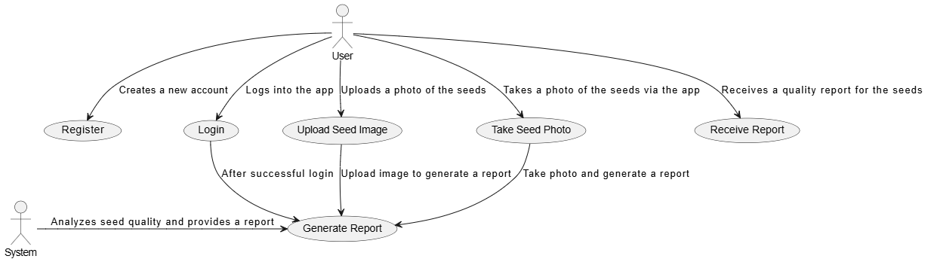
Use case

Slide 13
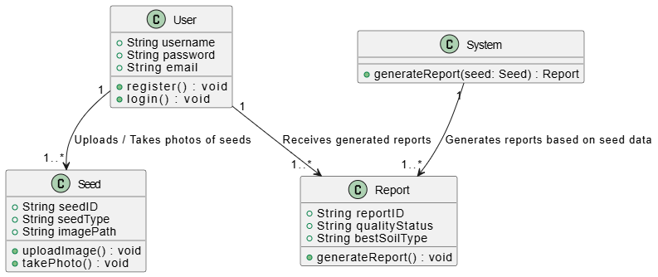
Class diagram

Slide 14
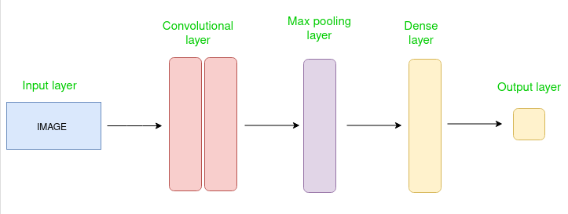
CNN Architecture

Slide 15
Algorithm
Convolutional Neural Networks (CNNs) are a type of deep learning network designed for image processing. They are great at identifying patterns and features in images, such as shapes and details.
Key features of CNNs:
Convolutional layers: Detect basic features in the image, like edges and shapes.
Pooling layers: Reduce the image size while retaining important features.
Fully connected layers: Use the detected features for final classification.
Activation functions: Allow the network to learn complex patterns.
Transfer learning: Using pre-trained models like VGG16 to quickly adapt the network to new tasks.
These features make CNNs perfect for detecting seed quality and classifying them as healthy or unhealthy.

Slide 16
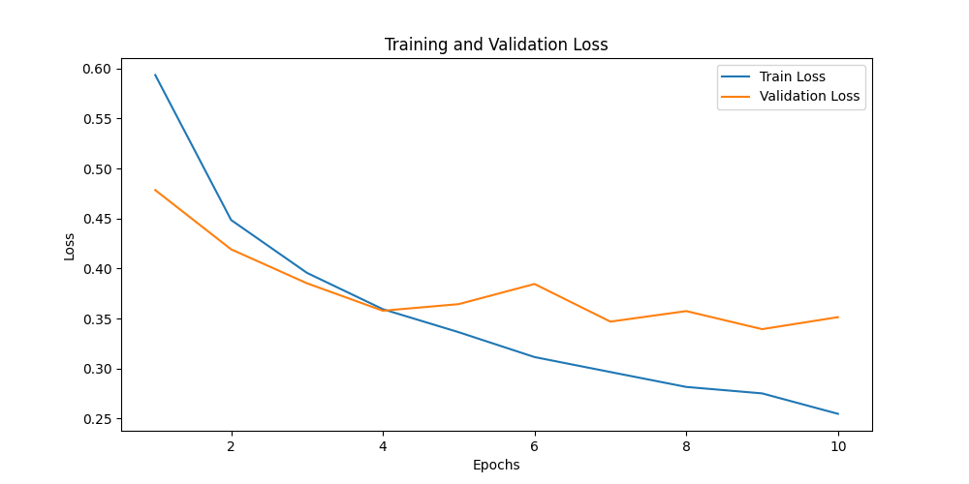
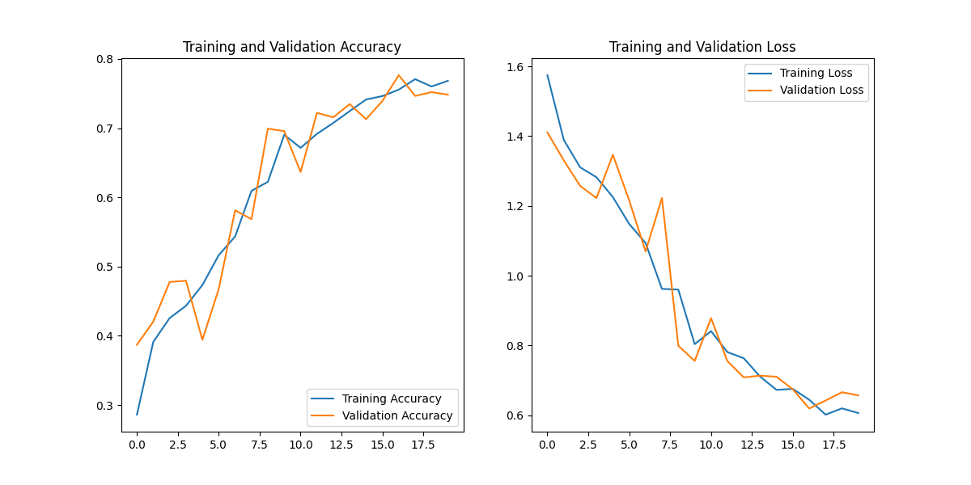
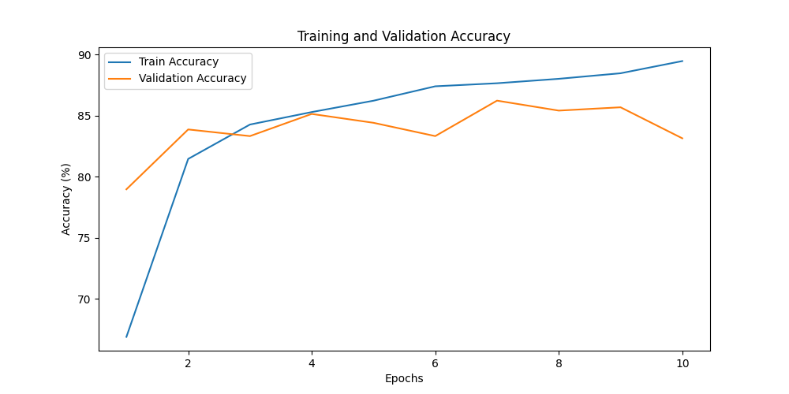
Soybean Results

Slide 17
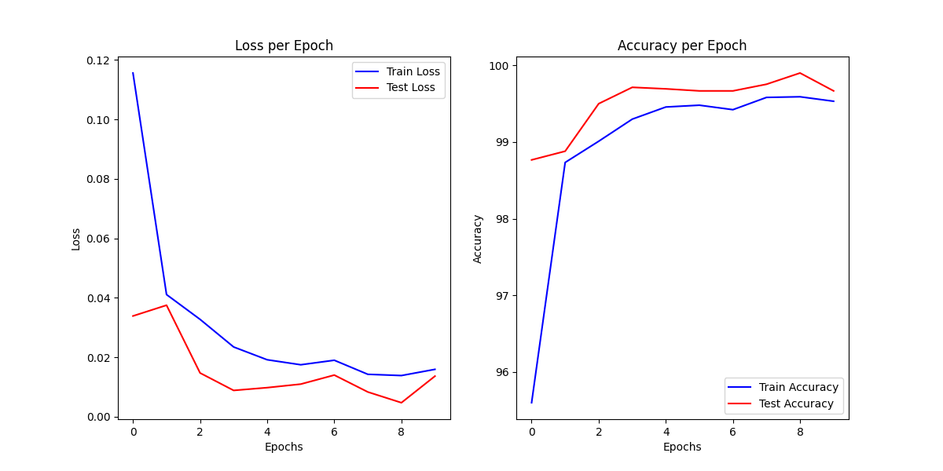
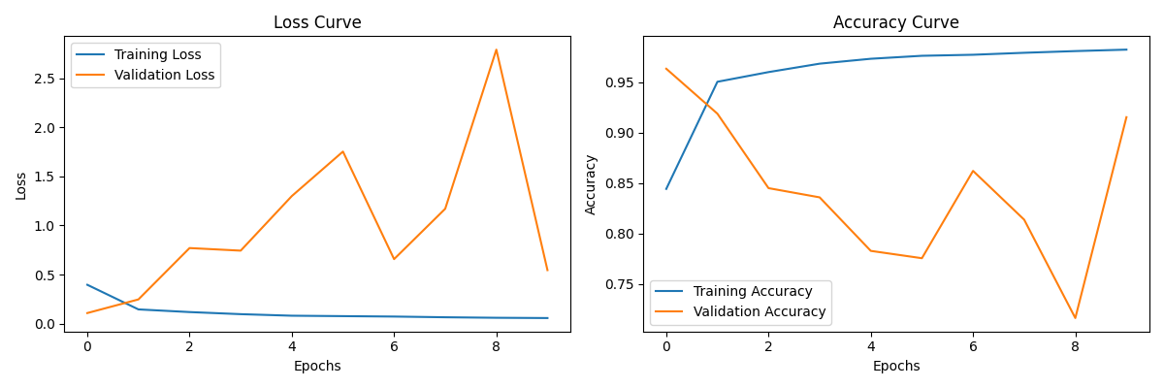
Rice Results

Slide 18
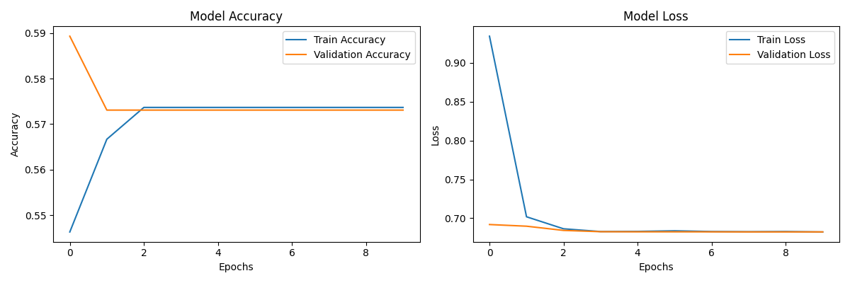
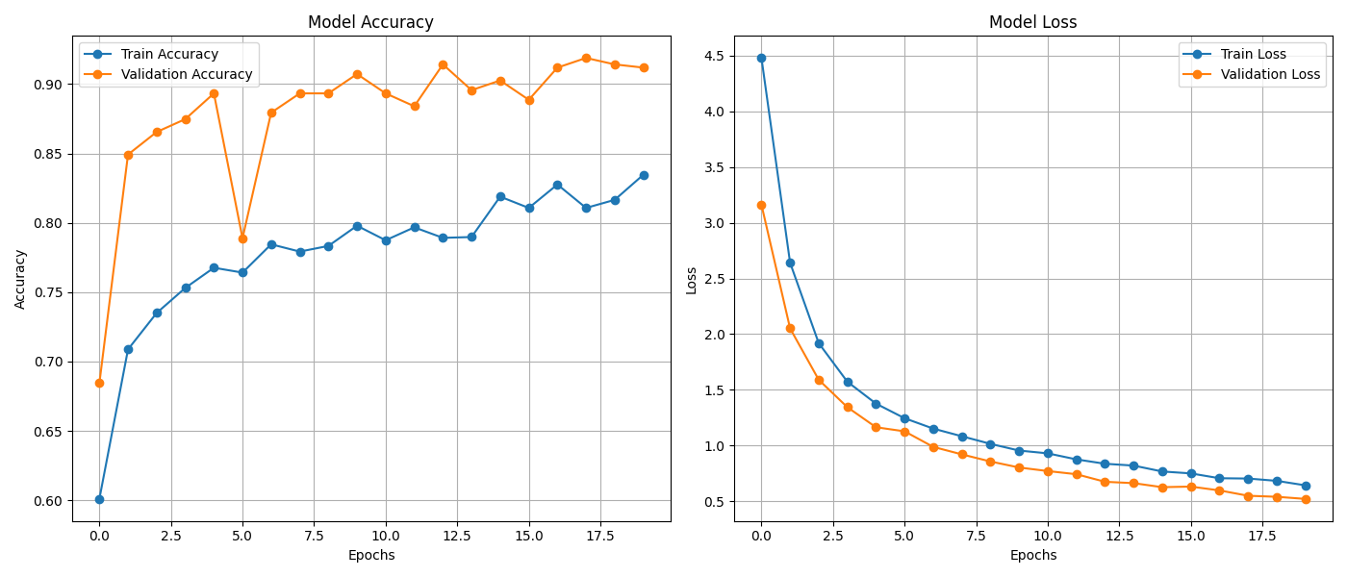
Pistachio Results

Slide 19

Demo

Slide 20
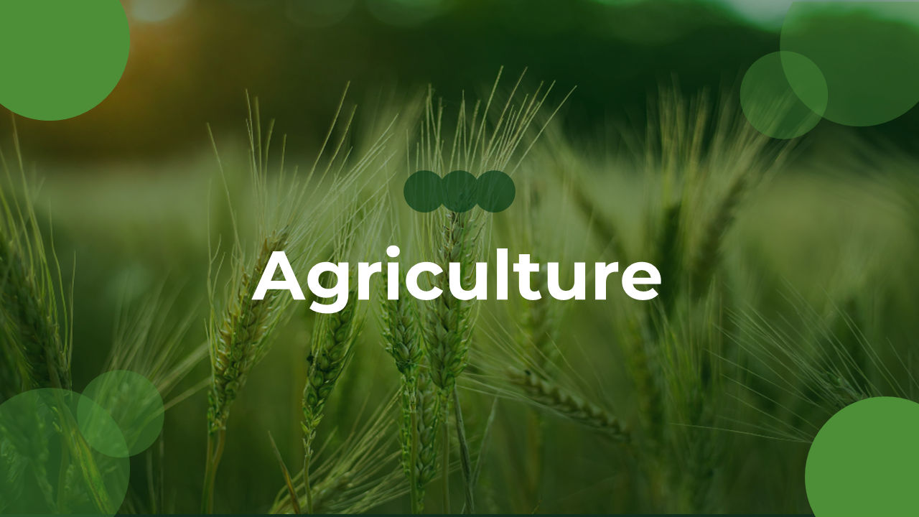
Conclusion
"SeedGuard uses deep learning to accurately detect and classify seed quality, ensuring healthier crops. By analysing seed images, it identifies healthy and unhealthy seeds, enabling early detection and better crop management, promising improved agricultural productivity and sustainability."

Slide 21
References
1-Kucukvar, M., & Tatari, O. (2020). "Machine Learning-Based Assessment of Soybean Seed Quality: A Case Study." Electronics, 11(7), 981. https://doi.org/10.3390/electronics11070981
2-Elbanna, A. A., & Awad, N. (2020). "Improving Seed Quality and Classification: A Deep Learning Approach." Paleontologia, 23(2), 9686. https://doi.org/10.23751/pn.v23i2.9686
3-Zhou, C., & Xu, M. (2021). "Computer Vision Techniques in the Detection of Soybean Seed Quality." Computers and Electronics in Agriculture, 185, 106285. https://doi.org/10.1016/j.compag.2021.106285
4-Sivrikaya, M., & Kilic, B. (2021). "Deep Learning in Agricultural Seed Classification." South Journal of Agricultural and Food Sciences, 25(4), 252-263. https://doi.org/10.15316/SJAFS.2021.252
5-Tuncel, Y. & Ozturk, S. (2021). "Soybean Seed Quality Assessment Using Convolutional Neural Networks." Ankara University Journal of Agriculture and Forestry, 42(3), 112-118. https://doi.org/10.15832/ankutbd.862482
6-Ali, R., & Khokhar, A. (2021). "Evaluation of Seed Quality through Image Processing and Deep Learning." International Journal of Image Processing and Applied Engineering, 10(4), 353-358. https://doi.org/10.18201/ijisae.2019355381
7-Soyabean Seed Data, Kaggle. (2020). "Soyabean Seed Classification Dataset." Kaggle. https://www.kaggle.com/datasets/warcoder/soyabean-seeds/data

Slide 22
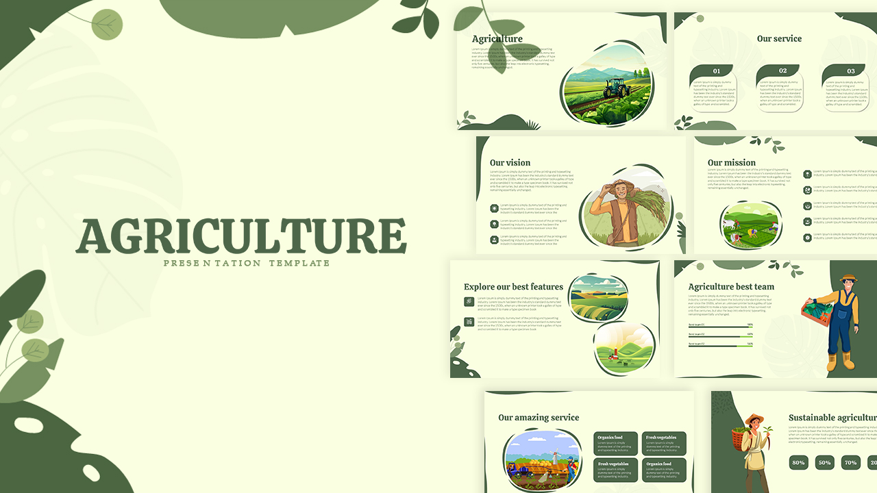
Thanks…… Any question?

